Slide 1

Optimize Join Implementation for All Version of MySQL
Group 5 :
陳憶賢 (YI-HSIEN CHEN)
陳品瑄 (PIN-XUAN CHEN) 黃尹姿 (HUANG YIN TZU)
莊惠文 (CHUANG HUI WEN) 劉易霖 (LIU, YIH-LIN)
Notes:
大家好，我們這組要報告的內容是優化Join的處理效率適用於所有的mysql版本

Slide 2
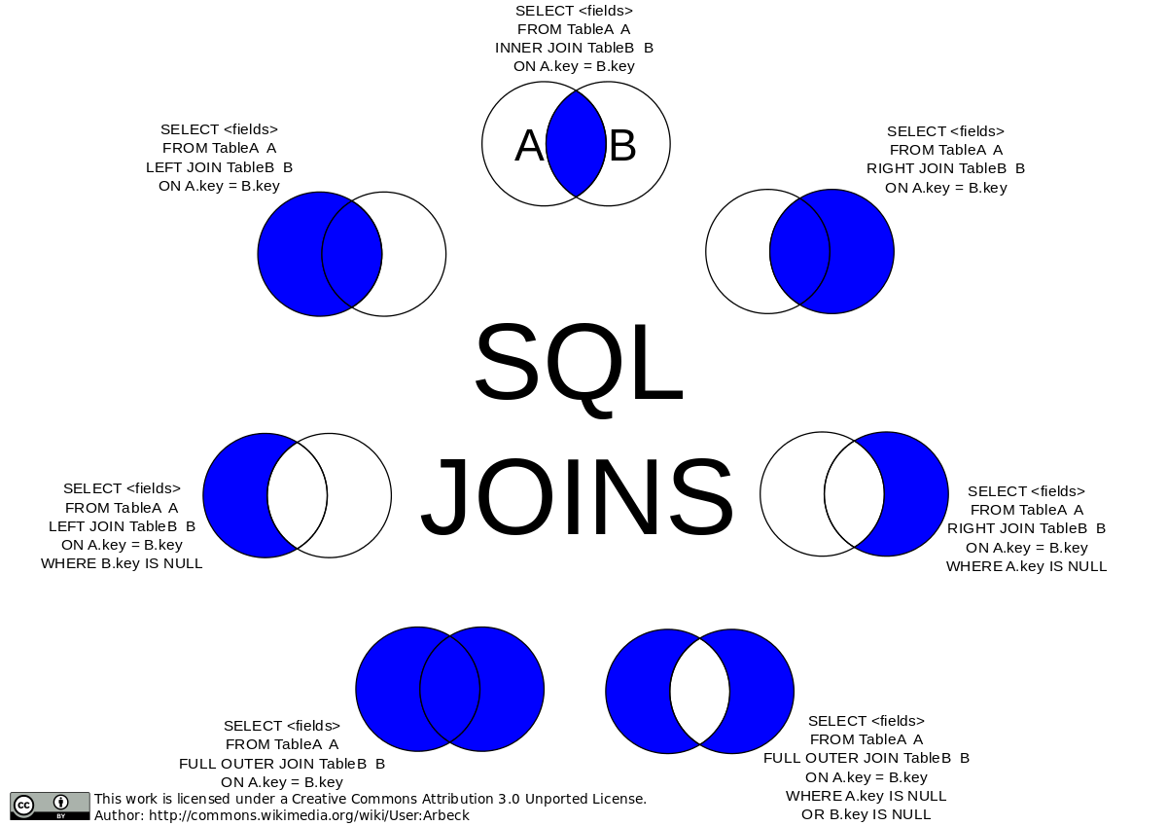
JOIN clause in SQL
In SQL, JOIN is always performed between two tables at one time.
For three table join, we need to go through sequential execution
Notes:
在SQL會使用JOIN來取出兩個table相交集的資訊，圖中可以看到根據使用者的需求有不同語法
但當使用者要做兩個以上table的交集，就必須以繁瑣的JOIN語法進行處理

Slide 3
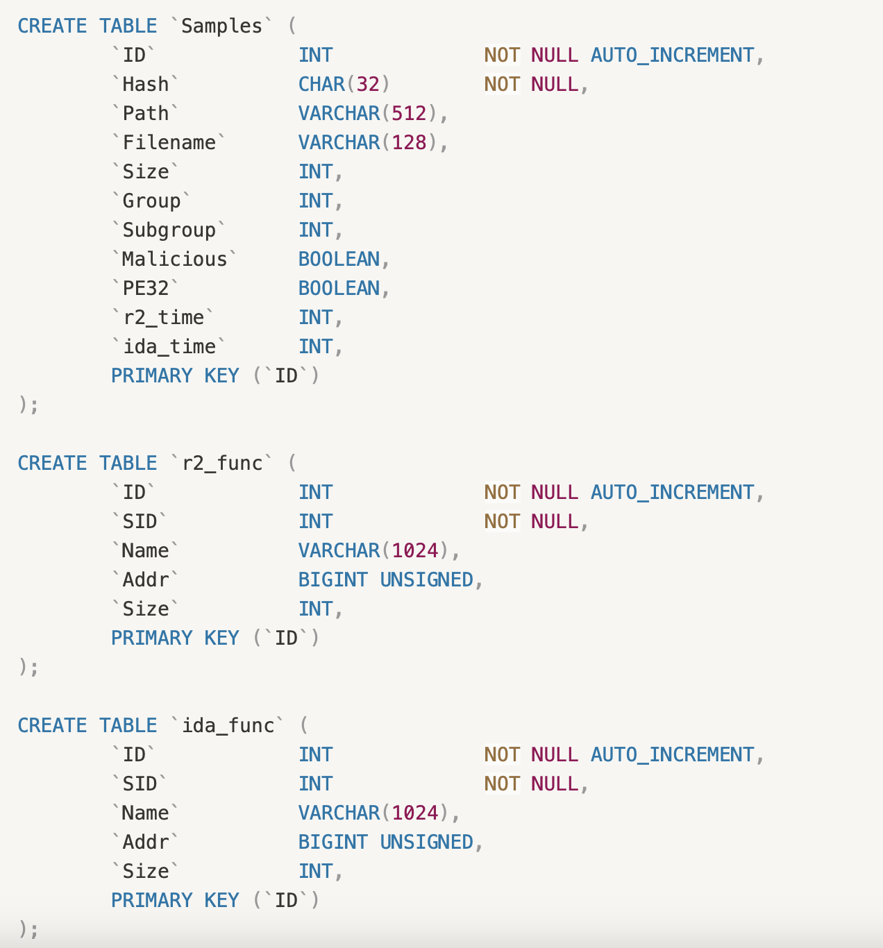
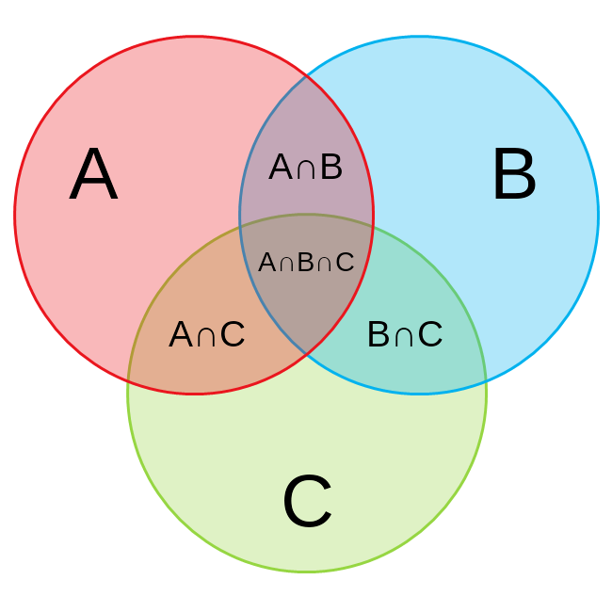
Example: finding the A∩C among three tables
There are three tables recoding function dictionaries. We want to find the specific A∩C tuples by JOIN on ID columns
Notes:
舉個例子
假設今天手上有三個記錄不同網頁在一段時間內接收到的函數table
且每個table內有不同的column，唯一共通的就是這些函數的function ID
假設今天我們想知道r2_function table有哪些是和sample function且ida function沒有接收到的function，也就是取出venn diagram 中A交集C且差級B這一塊的tuple

Slide 4
SQL code for three table join
Samples
ida_func
SELECT Samples.ID, Samples.Malicious,
COUNT(DISTINCT r2_func.ID) AS r2_func_count,
COUNT(DISTINCT ida_func.ID) AS ida_func_count,
COUNT(DISTINCT CASE WHEN r2_func.Addr = ida_func.Addr THEN r2_func.ID END) AS common_records_count
FROM Samples
INNER JOIN r2_func ON Samples.Valid=True AND Samples.ID = r2_func.SID
LEFT JOIN ida_func ON Samples.ID = ida_func.SID
GROUP BY Samples.ID, Samples.Malicious
ORDER BY Samples.Malicious, ida_func_count;
r2_func
Notes:
若以SQL處理，首先我們要以 INNER JOIN求出sample 和 r2_function 的交集
接著以 LEFT JOIN 來排除sample, r2_function 以及第三個table ida_function的交集
在整個過程中，SQL其實會將所有的column 資訊拿來做cross

Slide 5
Problem and Project Aims
In the whole JOIN process, we only utilize ID columns and column for COUNT function
While we only need parts of the table, the JOIN clause may process all possibile combinations in the table
→ the unnecessary attributes are included and duplicated multiple times during JOIN process, consuming times and spaces
We want to find an optimized method to make multi-table JOIN process efficiently.
Notes:
在做Join的過程中時常會把非必要的attributes也複製一次，造成記憶體的浪費與花不必要的時間，所以我們想要找到一個方法來悠化這個問題，並且這個方法可以適用於各個版本的mysql。

Slide 6
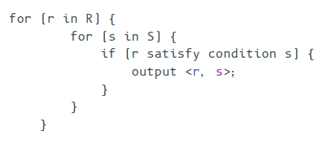
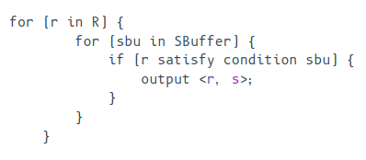
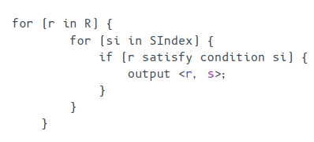
MySQL join implementation: Nested-Loop Join- O(MN)
Simple Nested-Loop Join
Block Nested-Loop Join
Index Nested-Loop Join
Notes:
在進入講解我們的方法前先介紹join implementation 目前在MYSQL中，Nested-Loop Join 可說是最古老的join算法，而後出現 Index 和 Block 兩種算法。從MySQL 8.0.2版本後廢棄Block算法，因為hash join的加入， Block開始被hash join取代。不過若是使用舊版本mysql依然只有Nested-Loop Join可以使用

Slide 7
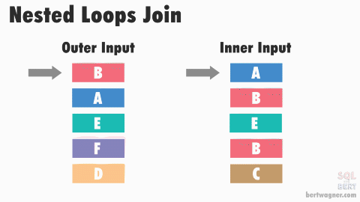
Simple Nested-Loop Join
Notes:
從這個動畫可以發現Simple nested loop join是一個發常沒有效率的join算法，處理過程中會掃描所有outer與inner的所有row，導致提取一堆不須要的資料

Slide 8
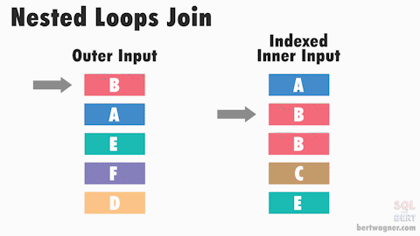
Index Nested-Loop Join
Notes:
為了解決前述方法過度掃描的問題，Index Nested-Loop Join會將inner table 先進行排序減少與要整張標都需掃描問題。

Slide 9
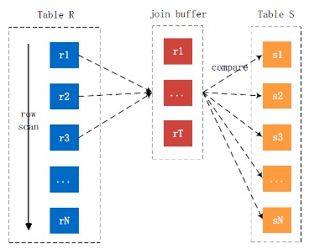
Block Nested-Loop Join
Notes:
BNLJ在SNLJ的基礎上使用了join buffer，會提前讀取Inner Loop所需要的 記錄到buffer中，以提高Inner Loop的效率。

Slide 10
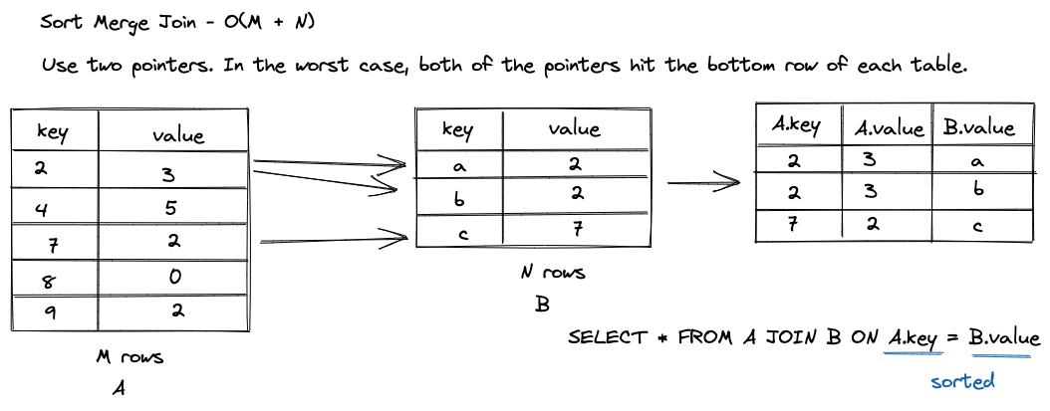
Sort-Merge Join - O(M + N)
Notes:
隨著sql技術的發展其他DBMS開始推出效率更好的join算法，MYSQL也在新的版本中加入Sort-Merge Join

Slide 11
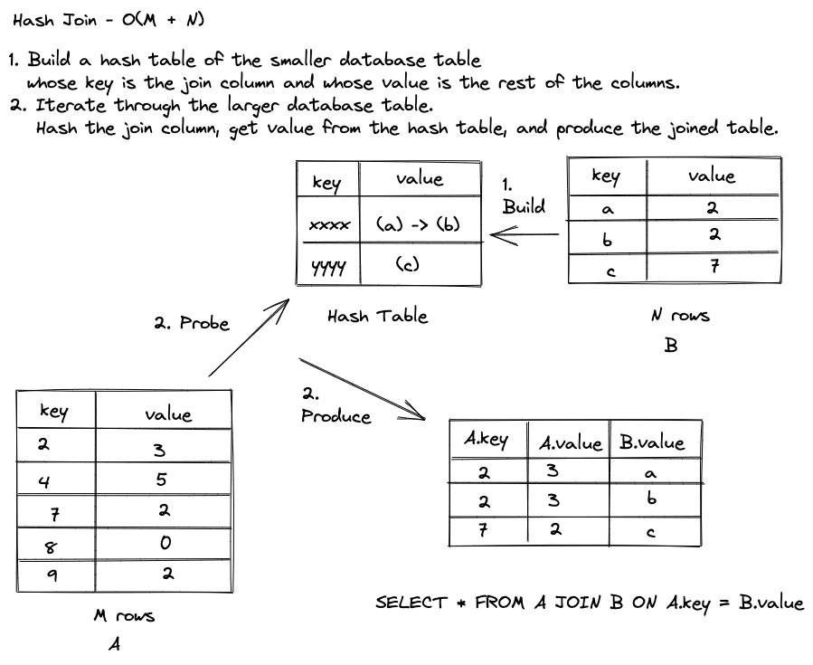
Hash Join - O(M + N)
Notes:
Hash Join 也是新加入join算法，主要是處理沒有排序的資料。

Slide 12
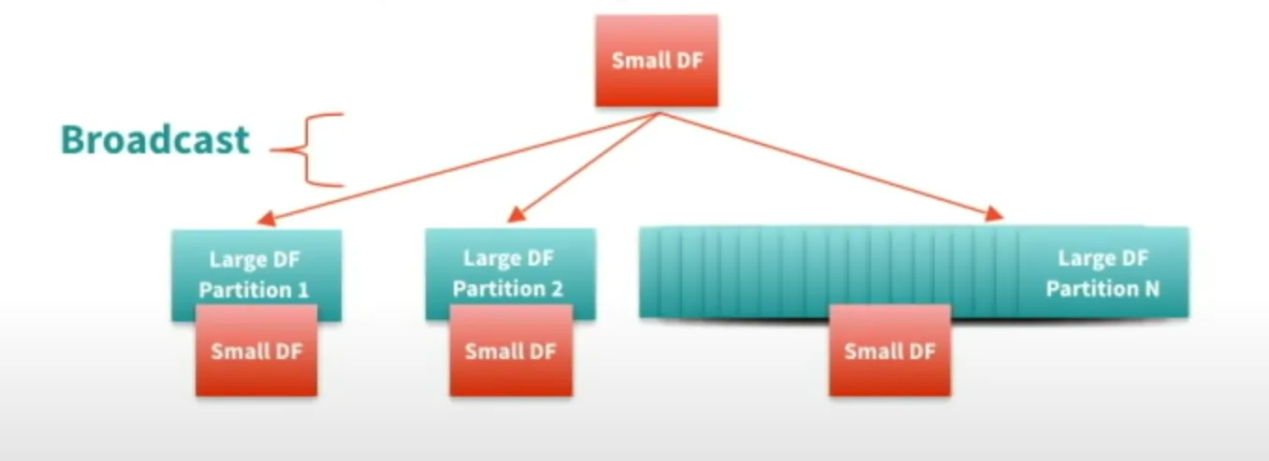
Broad Cast Join :
Notes:
Broad Cast Join 是一種分散式處理Join的方式，執行過程中會將大表切分成小部分再與小表做Join，這個過程全部都在內存中進行所以可以降低讀取記憶體所耗的時間。

Slide 13
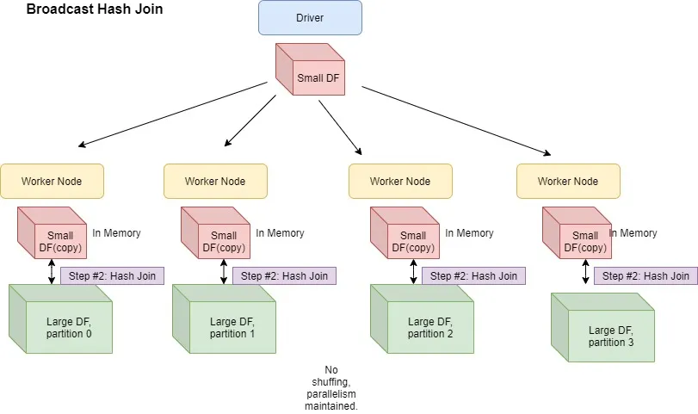
BroadCast Hash Join
Notes:
broadcast hash join使用與前一頁一樣的切分大資料的方式，搭配hash-join達到更好的處理效率

Slide 14
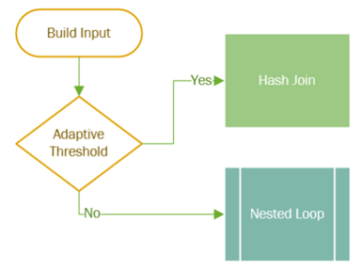
Adaptive Join
ln Microsoft SQL Server, Adaptive Join is a feature introduced in SQL Server 2017 that enhances the performance of join operations by dynamically selecting the most appropriate join algorithm based on runtime conditions.
Adaptive Join is particularly beneficial in scenarios where the performance of join operations can vary significantly depending on the size and distribution of the data, as well as the available system resources.
Notes:
Microsoft SQL Server推出的自式應調節Join，它會根據table的大小自動決定要使用hash join或是nest join，那為什麼要要切換模式呢，看到下一頁

Slide 15
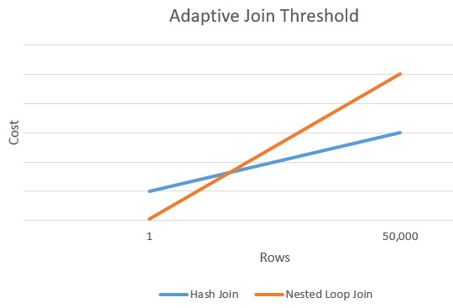
Notes:
會發現hash join在資料集較大時才有節省時間的效果，反而在資料集較小的情況下nest loop join 能更節省處理時間。

Slide 16
Comparison
Algorithm | Time Complexity | Conditions
Nested Join | O(MN) | —-
Sorted-Merge Join | O(M+N) | Joining columns are sorted
Hash Join | O(M+N) | O(N) space in memory
Broadcast Hash Join | O(M+N) | Only supports equijoin
Notes:
比較不同型態join所花的時間會發現，新型態的join技術可以透過資料切分、排序等手段加速處理過程，不過新的Join沒辦法適用於所有情況與所有版本的mysql

Slide 17
Methodology
We proposed to optimize the join process through the following steps:
Select and store attributes that are used in the following steps.
Build a red black tree based on join condition to enhance matching speed.
Instead of copying data for each row, store the address of the original data.
Notes:
統整完傳統與新形態的join算法。接下來說明我們提升效率的方法，我們的目的是去優化join算法，並且適用於所有版本的MYSQL，透過挑出必要的attributes，比對特定的attributes產生ID建立紅黑樹來增加match的速度，這樣可以避免複製過多不必要的資訊做資料比對。

Slide 18
Methodology - Select and Store The Minimum Attributes
SELECT Samples.ID, Samples.Malicious,
COUNT(DISTINCT r2_func.ID) AS r2_func_count,
COUNT(DISTINCT ida_func.ID) AS ida_func_count,
COUNT(DISTINCT CASE WHEN r2_func.Addr = ida_func.Addr THEN r2_func.ID END) AS common_records_count
FROM Samples
INNER JOIN r2_func ON Samples.Valid=True AND Samples.ID = r2_func.SID
LEFT JOIN ida_func ON Samples.ID = ida_func.SID
GROUP BY Samples.ID, Samples.Malicious
ORDER BY Samples.Malicious, ida_func_count;
Notes:
這一步是提取我們在三個表中需比對的Attributes，並比對ID的程式碼

Slide 19
Methodology - Select and Store The Minimum Attributes
Samples
ID
Malicious
Valid (don’t need to be saved)
r2_func
ID
SID
Addr
ida_func
ID
SID
Addr
Notes:
首先這邊分別列出需要用到的attribute

Slide 20
Methodology - Select and Store The Minimum Attributes
After deciding the attributes needed to be selected,
Select the first table (samples).
There is a join condition ‘sample.Valid=True’, which can be moved to here.
Only select ID, Group, Malicious, Valid
Select the second table (r2_func).
Only select ID, SID, Addr
Join the first and second tables as a new table T.
Select the third table (ida_func).
Only select ID, SID, Addr
Join T and the third table.
Notes:
在選取需要用的attributes後，先對samples table每個row的資料是否有效。再來選取r2_func table 與 samples table 做join 在對第三個ida_fuction做join

Slide 21
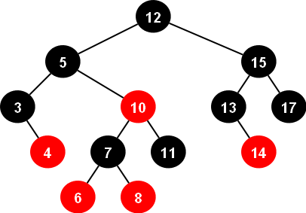
Methodology - Build Red-Black Tree for Join
The original nested join, and it requires O(nm) time complexity.
We proposed to use Red-Black Tree, a kind of self-balanced tree.
The time complexity would be O(nlogm)
The comparison condition on building the tree is set to be the join condition.
In our example, Samples.ID = r2_func.SID
So the tree is built by Samples.ID, and then we can use r2_func.SID to search it.
Samples
Built by ID
Search by SID
r2_func
Notes:
但如果直接用原本mysql的方式進行join會花掉太多時間，所需花的時間是三個表row的長度相乘，顯然沒有效率。所以我們比對Samples.ID與 r2_func.SID去建立紅黑樹，接下來r2_func再透過SID去比對解果是否正確，正確連接對應的table

Slide 22
Methodology - Save Data Reference
Instead of copying data for each row during join, we maintain their reference (memory address) in a custom data structure.
Sample[0]
Sample[1]
Sample[2]
left_table[0]
ida_func[0]
Sample[0]
r2_func[0]
ida_func[0]
ida_func[1]
ida_func[2]
left_table[0]
ida_func[1]
Sample[0]
r2_func[1]
r2_func[0]
r2_func[1]
r2_func[2]
left_table[0]
ida_func[2]
Sample[0]
r2_func[2]
Final table with data from three tables
Notes:
使用比對ID這個方法大幅減少再做join時大量複製資料所產生的空間浪費，最後我們可以透過配對的ID連接三個table

Slide 23
Methodology - Save Data Reference
How much memory space are saved?
Each row from Sample uses int + int + boolean = 32 + 32 + 1 = 65 bits
Each row from r2_func / ida_func uses int + int + int = 32 + 32 +32 = 96 bits
For each pair, we need 65 + 96 + 96 = 257 bits
In our data structure, we need 4 address = 64*4 = 256 bits
Although it’s not obvious in this data, it would be effective under:
More join
More space needed for each row
Notes:
使用我們的方法在這個資料庫中資料庫，雖然我們沒有辦法顯著的減少記憶體的使用空間，但如果有更多row的資料庫或是使用更複雜的join減少記憶體的使用空間會有更顯著的提升。

Slide 24
Evaluation
Time
MySQL: 10:43
Our proposed approach: 4:16
Space
MySQL: 58 GB (on disk)
Our proposed approach: 23.96 GB (in memory)
Notes:
經過我們優化後處理同比資料時間能從10分鐘降到4分鐘左右，儲存空間也可以減少大約25G的儲存空間。

Slide 25
Work Distribution
Introduction 陳品瑄 (PIN-XUAN CHEN) Background 黃尹姿 (HUANG YIN TZU) 莊惠文 (CHUANG HUI WEN)
Methodology 陳憶賢 (YI-HSIEN CHEN)
Evaluation 陳憶賢 (YI-HSIEN CHEN) Video 劉易霖 (LIU, YIH-LIN) 陳憶賢 (YI-HSIEN CHEN)
Notes:
最後是工作分配表

Slide 26
Thanks for listening
Notes:
謝謝大家

Slide 27
Video Link
https://www.youtube.com/watch?v=Inw_wWsPWWU
Notes:
最後是工作分配表

